Slide 1
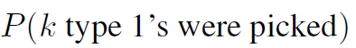
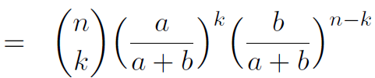
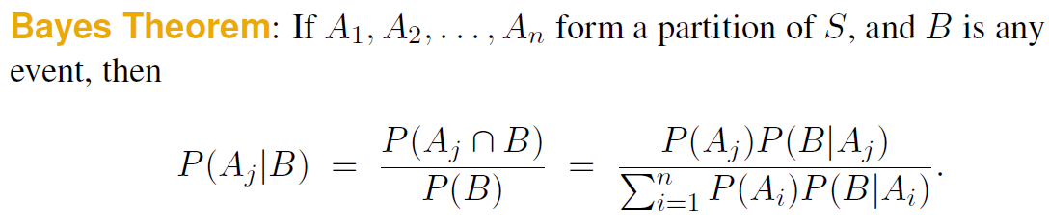
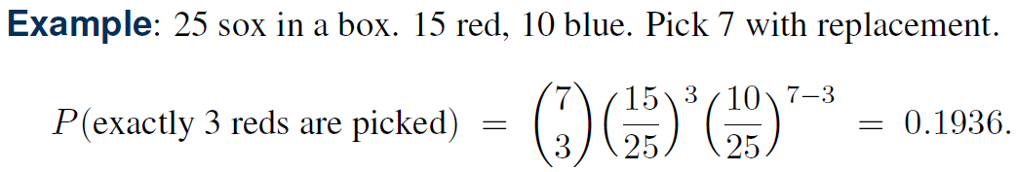
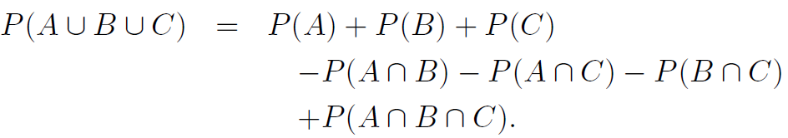
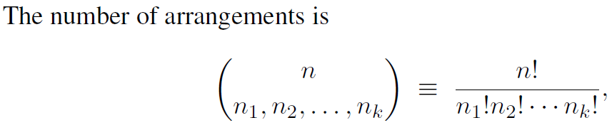
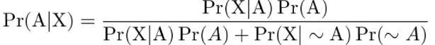
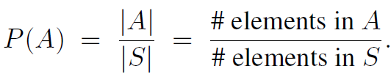
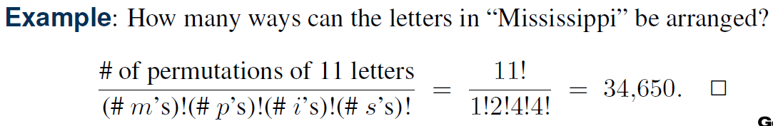
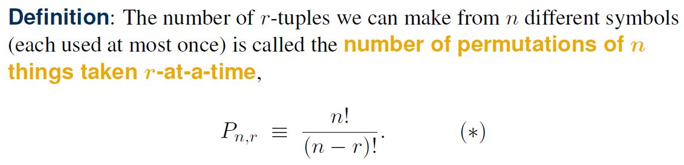
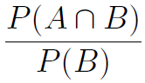
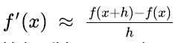
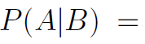
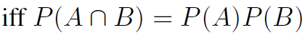
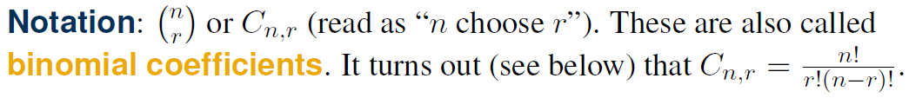
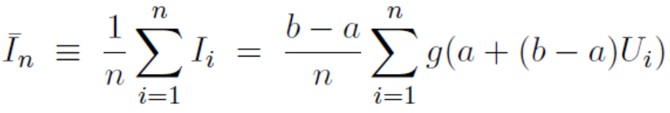
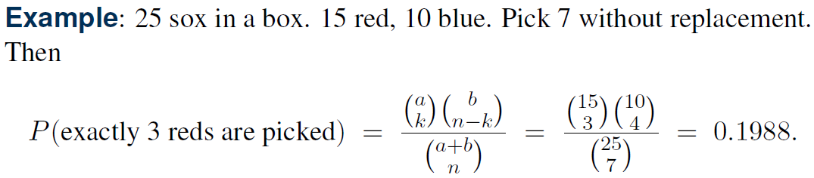
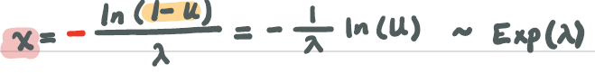
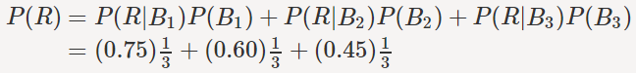
Lecture 1: Probability Introduction a. Basic Probability – A & B independent events
b. Finite Sample Spaces
c. Counting Techniques: Permutations
d. Counting Techniques: Combinations
e. Hypergeometric, Binomial, and Multinomial Probabilities
1. Number of type 1’s chosen has hypergeometric distribution
2. Number of type 1’s chosen has binomial distribution
3. Multinomial Coefficients
f. Permutations (order matters) vs. Combinations
g. Conditional Probability – (Bayes)
h. Independence
i. Partitions & Law of Total Probability
Sample Space Partition: split space into disjoint, yet all-encompassing subsets
i.e. Vowels and consonants form a partition of letters
i.e. A and not A form partition
Law of Total Probability:
i.e. I choose 1 of 3 bags at random and pick marble from chosen bag at random. What is probability that chosen marble is red?
j. Bayes Theorem
Uses Law of Total Probability
Alternative formula
Excluded if A & B mutually exclusive
k. Disjoint Probability
If two events A and B are disjoint, then the probability of either event is the sum of the probabilities of the two events: P(A or B) = P(A) + P(B)
Approximate derivative
If h is small
Monte Carlo integration → approximate Integral
Find distribution of U → 0.5ln(U)

Slide 2
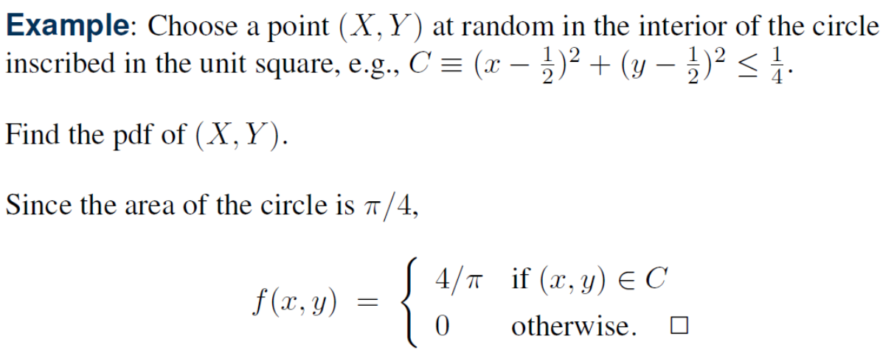
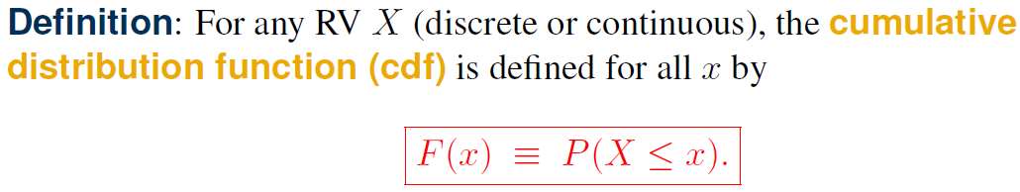
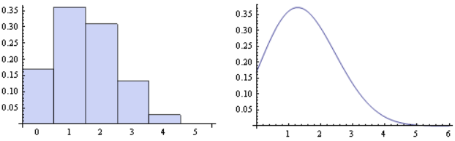
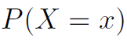
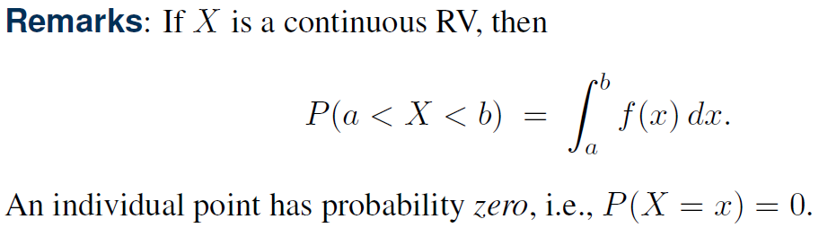
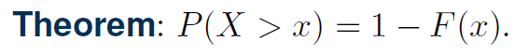
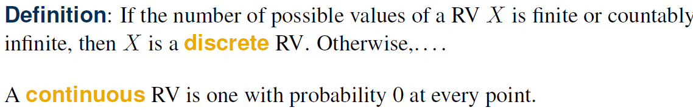
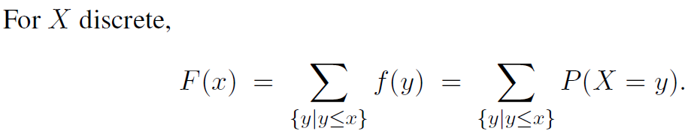
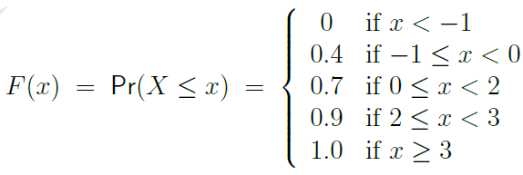
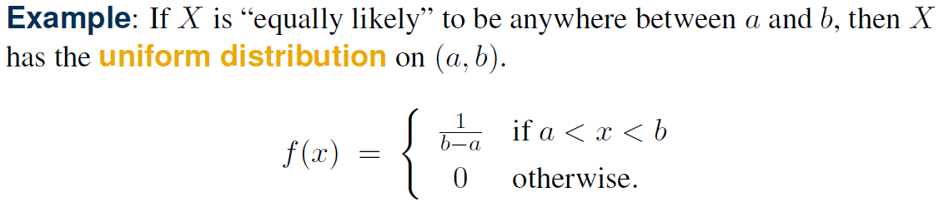
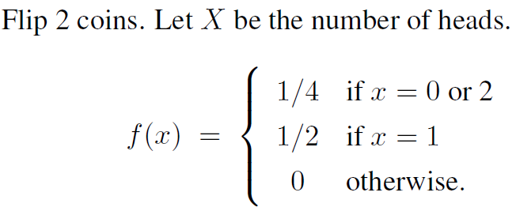
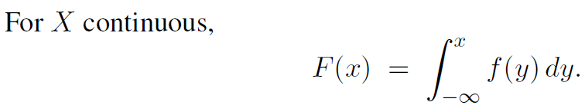
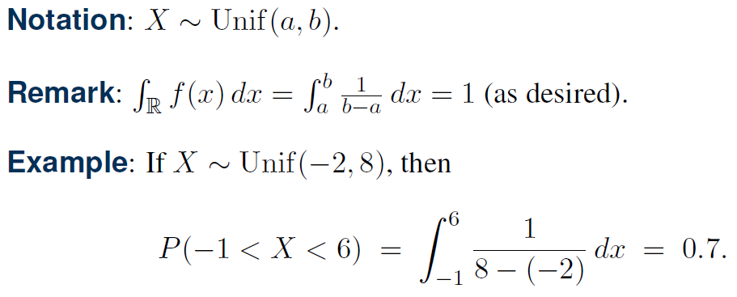
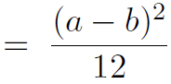
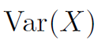
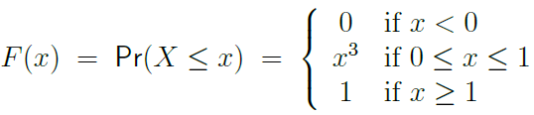
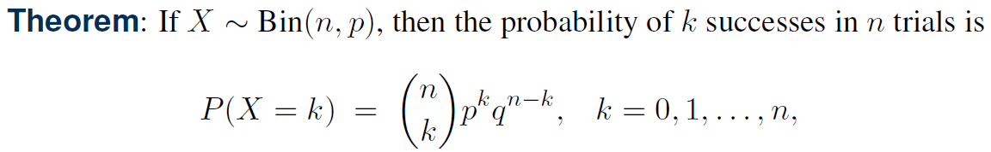
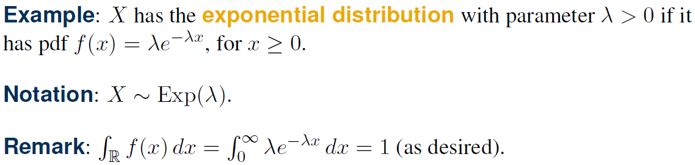
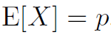
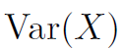
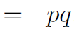
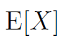
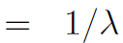
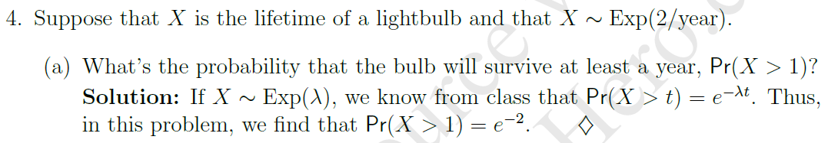
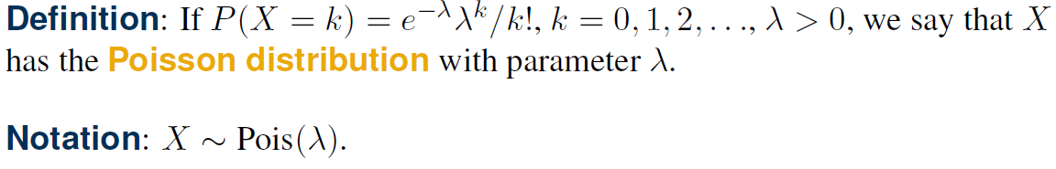
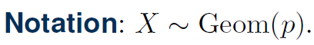
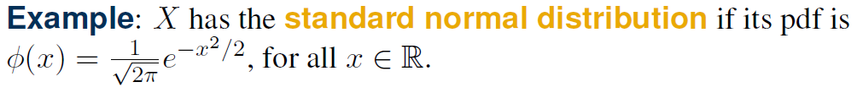
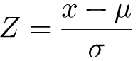
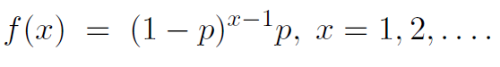
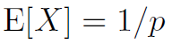
Lecture 2: Random Variables Part I a. Random Variable – function from sample space to real line
b. Discrete Random Variables
i. Bernoulli Trials / Binomial Distribution: X = number of “successes” from n independent trials; P(success) at each trial p
ii. Poisson Distribution:
iii. Geometric Distribution a. Number of Bern(p) trials until first success
c. Continuous Random Variables
Uniform Distribution:
Exponential Distribution:
Standard Normal Distribution
c. Cumulative Distribution Functions (cdf)
Pdf is 1/area
f(x) = 3x²
_{n}C_{k}
Memoryless Property

Slide 3
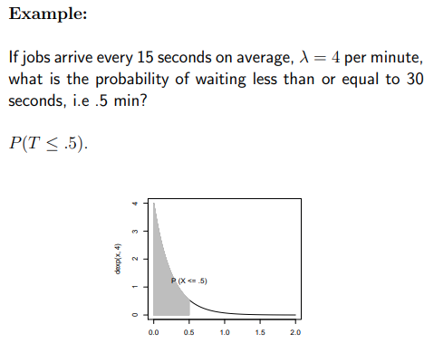





Exponential Problem: time between occurrences
Poisson Problem: # occurrences
1. Poisson
2. Option 1 Exponential / Continuous
2. Option 2 Poisson
Notes:
https://minisham.redbrick.dcu.ie/CA/Notes/CA266/16_The_Exponential_Distribution.pdf

Slide 4

Memoryless

Slide 5




















Lecture 2: Random Variables Part II (Expectations) a. Random Variable – Expected Value
Expected Value Examples
b. Random Variable - Variance
c. Functions of Random Variable X
i. Formulas
b. Moment Generating Functions (m.g.f)
ii. Discrete Example →
Covariance & Correlation

Slide 6





















b. Bivariate CDFs
Properties
c. Marginal Distributions of X and Y – Part I
c. Cumulative Distribution Functions (cdf)
d. Conditional Distributions
Lecture 3: Bivariate (Joint) Random Variables a. Consider 2 random variables simultaneously
i. Example
Double Integrals: find cdf of continuous pdf Single Integrals: marginal pdfs; conditional expectation
Integrating on x treat y like constant

Slide 7



Marginal Distributions of X and Y – Part II
Discrete, joint RVs: conditional + expectation
Continuous, joint RVs: conditional + expectation
Answer Linked Here

Slide 8




Lecture Slides Summary
Correlation Example, Discrete

Slide 9



Answer Linked Here
Answer Linked Here

Slide 10

























e. Independent Random Variables
f. Consequences of Independence
g. Random Samples
h. Conditional Expectation
Both RV X & Y are changing

Slide 11






i. Double Expectation

Slide 12










HW1

Slide 13




HW2

Slide 14























Lecture 4: Central Limit Theorem
Binomial Distribution

Slide 15





















Lecture 6: Confidence Intervals
Difference of 2 Normal Means (unknown equal variances)
Normal Variance
Ratio of Variances of 2 Normals
Difference of 2 Normal Means (variances unknown)
2-sided Confidence Interval (variance known)
Bernoulli Proportion
Difference of Paired Normal Means (variances unknown)
Use quantile
Necessary Sample Size
Difference of 2 Normal Means (variances known)
Normal Mean (variance unknown)

